Slide 1
LLDET
A
Automated Liquid Level Detection

Slide 2


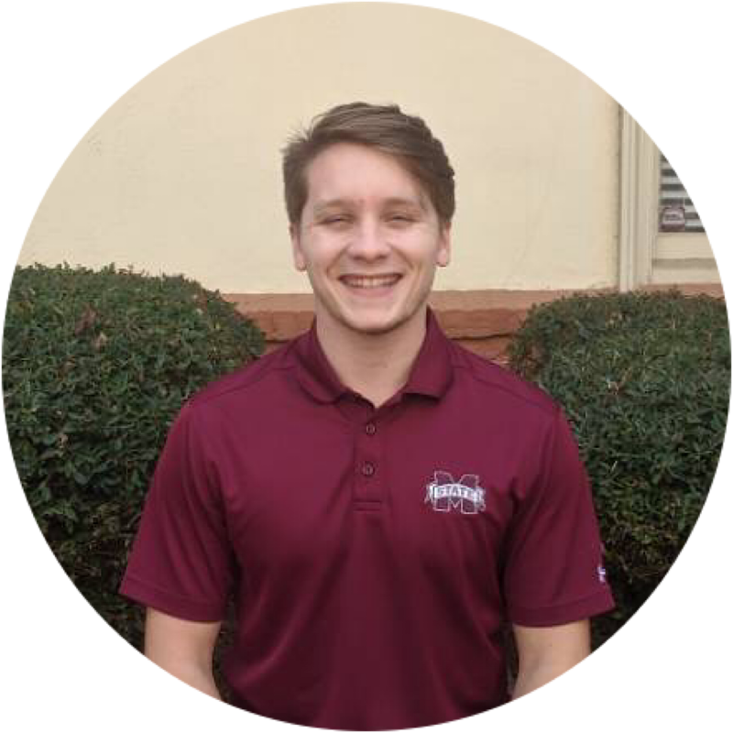
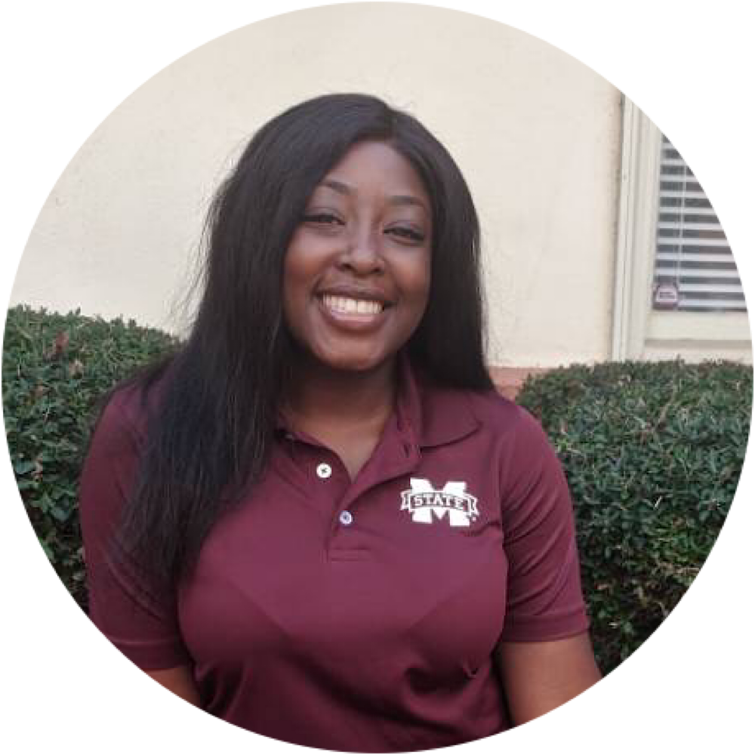
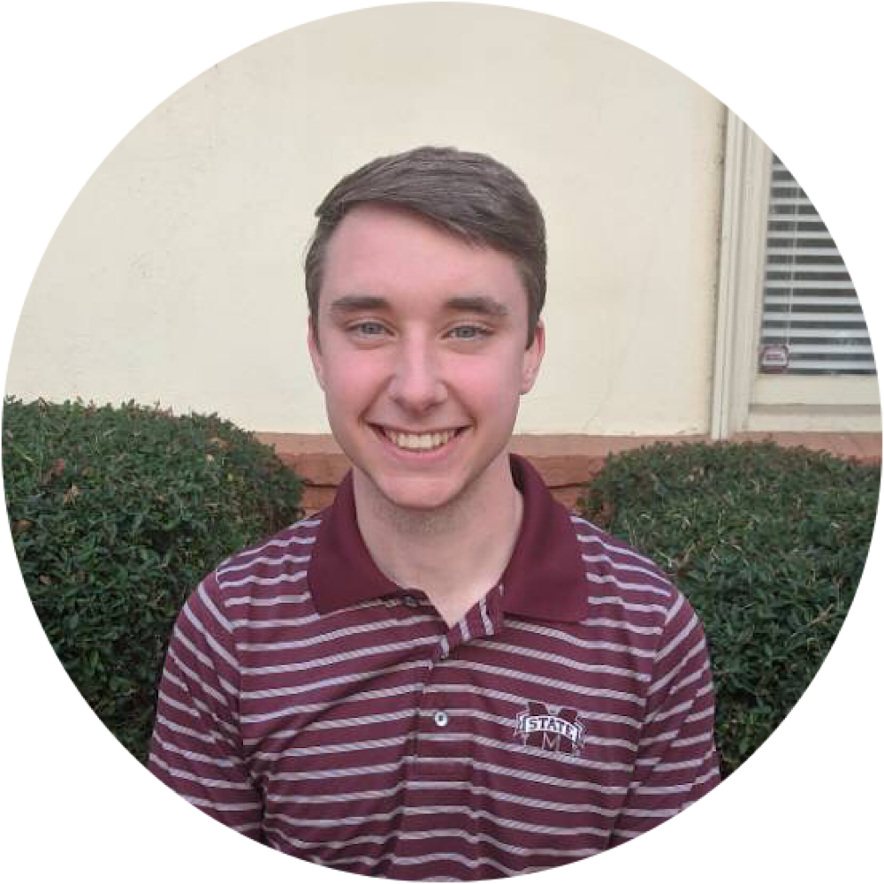
Team Members
Jesse Tutor - CPE
Zach Fauver - CPE
JR Ladd - EE
Khara Robinson - CPE
Andrew Bullington - EE

Slide 3

Introduction: Faculty Advisor
Assistant professor at Mississippi State University
Ph.D., Engineering Education, Virginia Tech, 2013
Undergraduate Engineering Education, Educational Data Mining, Scientific Visualization, Digital Image Processing
Dr. Jean Mohammadi-Aragh

Slide 4
Outline
Problem & Solution
Constraints
Evaluation
Timeline

Slide 5
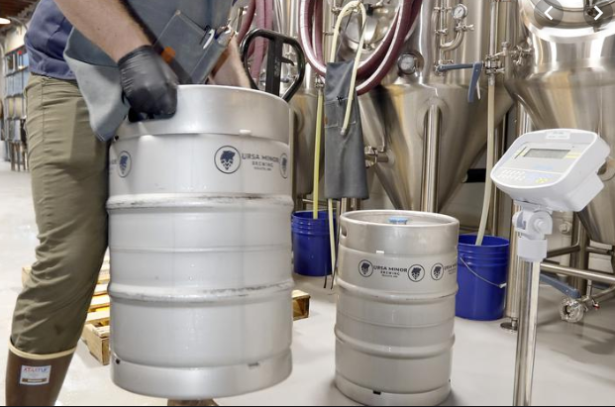
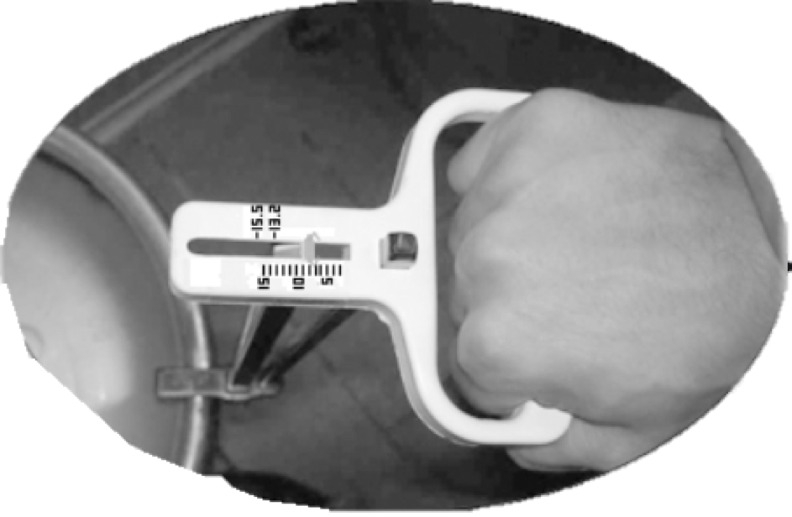
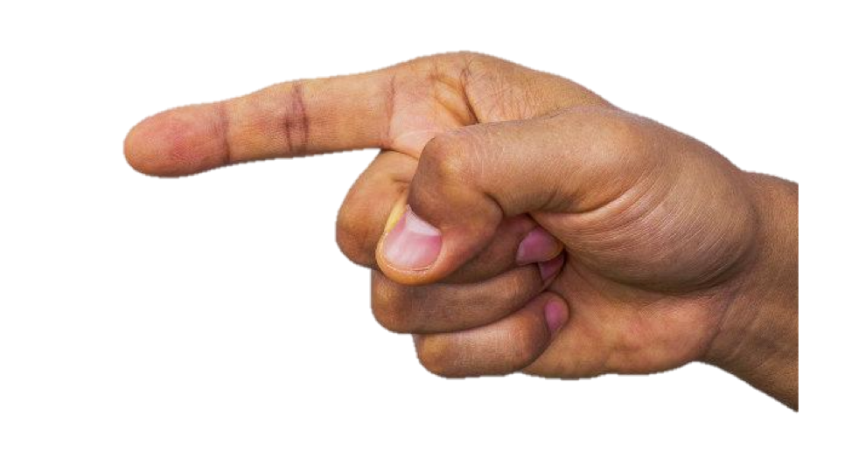
Problem Statement
Lack of convenient way to measure the liquid in a metal container
[1]
[3]
[2]

Slide 6
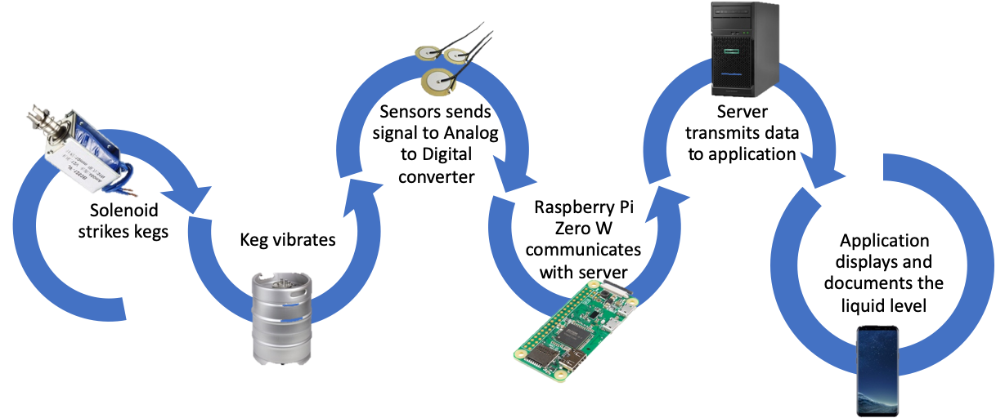
Solution Overview

Slide 7
Constraints
Practical
Technical

Slide 8



Practical Constraints
ECONOMIC
Cost less than $200
SOCIAL
Application use for liquid-level tracking
SUSTAINABILITY
Hands-free operation

Slide 9



Technical Constraints
ACCURACY
±5% of actual amount
BATTERY LIFE
16 hours continuous time
WIRELESS TRANSMISSION
9 meters range connection

Slide 10
Engineering Standards
Specific Standard | Standard Document | Specification/Application
IP52 | IP Rating Chart (IEC 60529) | Protects from water spray less than 15 degrees from vertical
IEEE 802.11N | WiFi Basic Specification | Used for sending and receiving data from the host device and a smartphone, compatible with the Raspberry Pi

Slide 11
Subsystem Tests
Wireless Testing
Accuracy Testing
Interference Testing
Temperature Testing
Battery Testing

Slide 12
Wireless Testing
Distance (meter) | Signal Strength (dBm) | Physical Structure Interference (Y or N)
3 meters
6 meters
9 meters
12 meters
Table 4.3.1 - Transmission tests

Slide 13
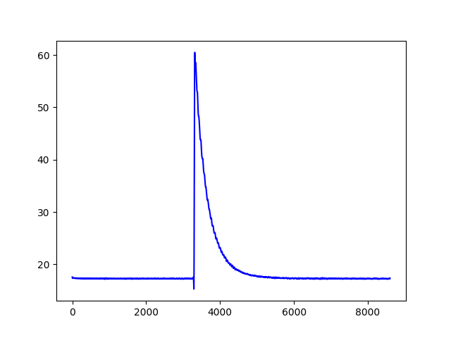
Accuracy Testing
Actual Value | Recorded Value
0%
33%
66%
100%
33% Non-Mayhew keg
Table 4.2.1 - Accuracy tests

Slide 14
Interference Testing
Volume in dB | Expected Result | Actual Result | % Error
20 dB
40 dB
60 dB
80 dB
Table 4.5.1 - Interference tests

Slide 15
Temperature Tests
Temperature | Expected Result | Actual Result | % Error
32°C
20°C
10°C
0°C
Table 4.1.1 - Temperature tests

Slide 16
Battery Tests
Temperature | 16 Hour Lifetime Y/N | Percentage left (%)
32°C
20°C
10°C
0°C
Table 4.4.2 - Battery tests

Slide 17
System Testing

Slide 18
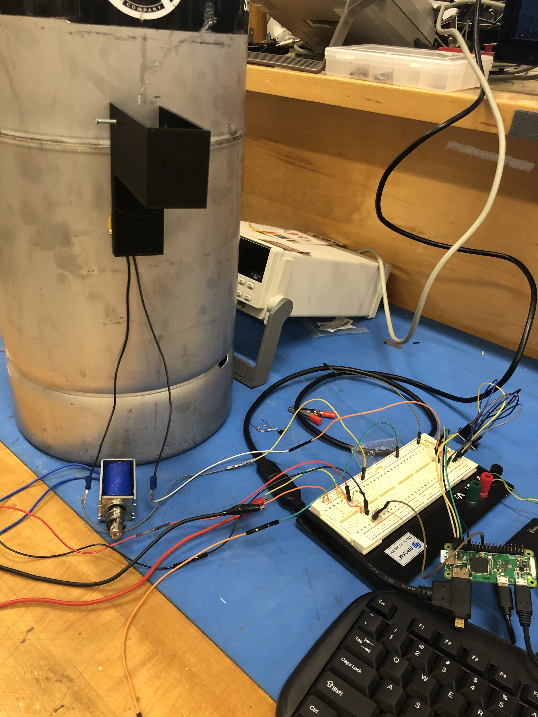
System Tests
Solenoid Activated by Raspberry Pi | Y/N
Resonance Captured by Sensors With <5% Error | Y/N
Transmission to Server Successful | Y/N
Transmission to App Successful | Y/N
Table 4.4.3 - System tests

Slide 19
Progress and Timeline
August
September
October
November
December
Design Demo
System Integration Testing
Subsystem Design Parts Order
Design Overview
Problem Research

Slide 20
Questions?
LLDET
A

Slide 21
References
[1] "Ursa Minor Brewing brings more beer, pizza to Lincoln Park | Duluth News Tribune." duluthnewstribune.com. https://www.duluthnewstribune.com/business/4513545-ursa-minor-brewing-brings-more-beer-pizza-lincoln-park (accessed Oct. 22, 2019).
[2] "On the Virtue of a Bent Finger: A Challenge for the Days of Awe | ReformJudiasm.org." reformjudiasm.org. https://reformjudaism.org/blog/2017/09/14/virtue-bent-finger-challenge-days-awe (accessed Oct. 22, 2019).
[3] “Keg Scale.” alcoholcontrols.com. https://alcoholcontrols.com/noname.html (accessed Sept. 3, 2019).

